Slide 1
Strategy Analysis

Slide 2
Agenda
Introduction
The Context for Strategy
What is Strategy?
Strategy Development
External Environment Analysis
Internal Environment Analysis
SWOT Analysis
Executing Strategy
Summary
Notes:
Agenda * Introduction * Aspects of Strategy Analysis * Purpose of Strategy Analysis * The Context for Strategy * Importance of Strategy in Business * Changes Affecting Strategy Development * Challenges in Strategy Formulation * What is Strategy? * Military Origins of Strategy * Components of Business Strategy * Definitions of Strategy * Issues in Strategy Analysis * Levels of Strategy * Strategy Development * Fundamental Questions in Strategy Development * Drivers of Strategy Development * Political Influence on Strategy * Importance of Written Strategy Statements * External Environment Analysis * Impact of External Changes on Business * PESTLE Analysis Framework * Competition Analysis using Porter's Five Forces * Scenario Planning for Future Impacts * Internal Environment Analysis * MOST Analysis Technique * Resource Audit * Portfolio Analysis using Boston Matrix * Purpose and Structure of SWOT Analysis * Executing Strategy * Contextual Issues in Strategy Execution * Role of Strategic Leadership * Tools for Strategy Execution: McKinsey 7-S Model * Tools for Strategy Execution: Balanced Business Scorecard * Summary of Strategy Analysis

Slide 3
Aspects of Strategy Analysis
Understanding Strategy
Definition and importance of strategy
Assumption that strategy is crucial
Development of Strategy
Ideas on how strategy is formulated
Implementation of Strategy
Methods to execute strategy effectively
Implications for Business Analysts
Understanding the impact of strategy on business analysis
Notes:
This chapter covers four key aspects of strategy analysis: understanding the importance of strategy, exploring how strategy is developed, implementing strategy, and analyzing its implications for business analysts. Original Content: This chapter is about four aspects of strategy analysis: understanding what strategy is and why it is important, the assumption being that strategy is important; exploring some ideas about how strategy is developed; implementing strategy; working out what all of this means for business analysts.

Slide 4

Purpose of Strategy Analysis
Purpose of Strategy Development
Not aimed at turning individuals into strategic planners
Focus on understanding the process
Comfort with Managerial Tools
Familiarity with tools used by managers
Ability to use these tools effectively
Application to Information Systems
Exploring new or different information systems
Enhancing organisational activities
Notes:
The goal is not to make you strategic planners but to help you understand strategy development. You'll become comfortable with managerial tools and learn to use them effectively. This knowledge will aid in exploring new information systems to enhance organisational activities. Original Content: There is no intention to try to turn you into strategic planners but instead to enable you to understand the process of strategy development, be comfortable with the tools that managers use and be able to use them yourself as you explore how new or different information systems could push forward the activities of the organisation that employs you.

Slide 5
Importance of Strategy in Business
Unpredictability in Business Environment
Business changes are becoming more turbulent
International mergers and acquisitions are frequent
Impact of Information Revolution and Digital Economy
Causing dramatic changes in business
Barriers between previously separate businesses are falling
Future Financial Players
Global banks, retail outlets, strong brands
Uncertainty in finance sector
Government Shareholdings
Long-term implications are unclear
Notes:
Organizations focus on strategy to navigate the unpredictable and turbulent business environment. The information revolution and digital economy are causing significant changes, breaking down barriers between businesses. Future financial players could be global banks, retail outlets, or strong brands. The finance sector faces uncertainty, and the long-term implications of government shareholdings remain unclear. Original Content: Why do organisations bother about strategy? What advantage do they hope to gain? Let us look at what is happening in the world. Most of us would probably support the idea that business is becoming increasingly unpredictable and changes are more turbulent, with international mergers and acquisitions once again becoming regular features of business life as economies come out of the post-banking crisis recession. The information revolution and the digital economy have caused much of this dramatic change and barriers between previously separate businesses are falling like dominoes. For example, who will be the big financial players in the future? It could be the global banks, retail outlets like Tesco or Walmart, strong brands like Amazon or Virgin. If you are working in the finance sector how do you know where to move next? What are the longer term implications of government shareholdings?

Slide 6
Changes Affecting Strategy Development
Changes in Employment
Increased use of part-time and contract employees
Employees have individual career and work/life balance plans
Knowledge-based industries are growing
Continuous change in organizations
Flattened Organizational Structures
Decentralized decision-making
Societal Changes
Organizational Responses
Global vs Local
Centralized vs Decentralized Structures
Hard and Soft Management
Notes:
Organizations face big changes, including shifts in employment, flattened structures, societal changes, and contradictions like global vs local markets. Strategy development must address these changes, balancing hard and soft management skills to increase flexibility and responsiveness. Original Content: There are some big changes that organisations face and that strategy development tries to moderate: There are the changes to the ways that we are employed. There is much more use of part-time and contract employees who may have little long-term loyalty to their employer and who have their own individual career and work/life balance plans. The growth of knowledge-based industries and the continuous change experienced by organisations means that individual employees, consultants or contractors – permanent, full-time or part-time – have become valuable assets. This is more than ever the case as organisations everywhere, in both Government and commercial sectors, flatten their organisation structures, decentralise decision-making and give more freedom to individuals to make decisions, deal with customers and resolve problems. There are no longer jobs for life and attitudes to work have changed. We all now want great job satisfaction, higher rewards, more personal recognition and flexible working environments. Society has changed. There is greater freedom of expression and of thought. Freedom of information legislation means that individuals have access to evidence and decisions taken by government that were previously hidden. There is less respect for authority and office unless it has been earned. Our attitudes to change, direction, reorganisation and other people knowing better than we do have shifted and the development and implementation of new strategies need to take this into account. Organisations are responding to these changes by doing everything they can to increase their flexibility and responsiveness. This means that they seek to reduce employment costs and without trade unions to apply a brake we see central government and European institutions taking this role. The world is full of contradictions. Some of these are: ..Global versus local. Globalisation creates the largest markets ever known and until we have intergalactic businesses this will remain the case! But it also means that the players in a global market can be small. Having a global reach does not mean being the biggest. The scarcity of the product, its brand reputation and its distribution channels make the difference. All the paparazzi know this; one paparazzo, with access to a camera, the right moment and the internet, sells his product across the world in less than a day. ..Centralised versus decentralised organisation structures. Finance may be a central process but prices and discounts are set locally. ..Hard and soft management. Developing strategy is seen as a ‘hard’ discipline like finance and technology but the creativity and change skills that make strategy work are the ‘soft’ skills.

Slide 7
Challenges in Strategy Formulation
Unpredictability of the Future
Future is inherently unknowable and unpredictable
Difficulty in creating, formulating, or building strategies
Decentralised Structures
Implementation challenges in decentralised structures
Delegated authorities complicate coherent strategy execution
Ever-changing Environment
Constantly changing business environment
Impact on the permanence of business strategies
Role of Business Analysts
Understanding the nature and permanence of business strategies
Effective Tools and Steps
Notes:
Formulating and implementing business strategies is challenging due to the unpredictable future, decentralized structures, and ever-changing environments. Business analysts must understand the nature and permanence of strategies and use effective tools to address these difficulties. Original Content: Finally there are two questions. How can anyone create, formulate or build a strategy if the future is inherently unknowable and unpredictable, and how can it be implemented in a coherent way in decentralised structures with delegated authorities and an ever-changing environment? This makes it appear very difficult for a business analyst to understand the nature and permanence – or impermanence – of the business strategies against which IS strategies are to be built. However, as we shall see, through an examination of the nature of strategy and the use of some well-tried tools, effective steps can be taken to deal with this difficulty.

Slide 8

Military Origins of Strategy
Military Origins of Strategy
Derived from Greek word 'strategia' meaning 'generalship'
Involves preparation for battle
Deployment of troops, weapons, aircraft, and ships
Battlefield Tactics
Determine success of the strategy
Transfer to Business Context
Easy to apply military concepts to business
Expectations in business strategy
Notes:
The concept of strategy originates from the military, derived from the Greek word 'strategia' meaning 'generalship'. It involves preparation for battle and deployment of resources. Battlefield tactics determine the success of the strategy. These ideas are easily transferred to business, where similar strategic planning is expected. Original Content: The concept of strategy begins in a military context and the word strategy is derived from the Greek word ‘strategia’ which means ‘generalship’. It has a ‘getting ready for battle’ sense to it and the deployment of troops, weapons, aircraft and ships before engagement with the enemy begins. Once the enemy is engaged then battlefield tactics determine the success of the strategy. The transfer of these ideas into business is easy to make, therefore, and we expect to deal with:

Slide 9
Components of Business Strategy
Goal or Mission
Defines the direction of the business
Time Frame
Strategy focuses on long-term goals
Varies across industries
Petrochemicals and pharmaceuticals have longer time frames
Domestic financial services have shorter time frames
Organisation of Resources
Includes finance, skills, assets, and technical competence
Ensures the organisation can compete effectively
Operating Environment
Includes the markets in which the organisation will operate
Notes:
Business strategy involves defining the goal or mission, setting a time frame, organizing resources, and understanding the operating environment. The time frame varies across industries, with petrochemicals and pharmaceuticals having longer durations compared to domestic financial services. Original Content: The goal or mission of the business. In strategy terms this is often referred to as the direction. The time frame. Strategy is about the long term. The problem here is that it differs widely across industries, with petrochemicals and pharmaceuticals at the really long end and domestic financial services products at the short end. The organisation of resources such as finance, skills, assets and technical competence so that the organisation can compete. The environment within which the organisation will operate and its markets.

Slide 10
Definitions of Strategy
Johnson, Scholes and Whittington (2008)
Strategy is the direction and scope of an organisation over the long term
Achieves advantage in a changing environment
Configuration of resources and competences
Aim of fulfilling stakeholder expectations
George Steiner (1979)
Strategy is what top management does
About direction
Process that sets in motion important actions
What the organisation should be doing
Notes:
Strategy has been defined in various ways. Johnson, Scholes, and Whittington describe it as the long-term direction and scope of an organization, aiming to fulfill stakeholder expectations. George Steiner paints a picture of strategy as what top management does, focusing on direction and necessary actions. Original Content: A popular definition appears in Johnson, Scholes and Whittington (2008): Strategy is the direction and scope of an organisation over the long term, which achieves advantage in a changing environment through its configuration of resources and competences with the aim of fulfilling stakeholder expectations. However, writers and gurus have offered their own definitions for at least the last 40 years including George Steiner (1979) who did not so much define it as paint a picture of it by saying that strategy is: what top management does; about direction; the process that sets in motion the important actions necessary to achieve these directions; what the organisation should be doing.

Slide 11
Issues in Strategy Analysis
Long-term Direction of an Organisation
Focus on future goals and objectives
Scope of an Organisation’s Activities
Range of operations and services
Advantage Over Competition
Unique strengths and competitive edge
Strategic Fit with Business Environment
Alignment with external factors and market conditions
Organisation’s Resources and Competences
Utilization of assets and skills
Values and Expectations of Powerful Actors
Influence of stakeholders and key players
Notes:
Johnson, Scholes, and Whittington (2008) outline key issues in strategy analysis. These include the long-term direction, scope of activities, competitive advantage, strategic fit, resources and competences, and values and expectations of powerful actors. Original Content: But finally, Johnson, Scholes and Whittington (2008) provide a helpful definition of the issues to be considered during strategy analysis. These are: the long-term direction of an organisation; the scope of an organisation’s activities; advantage for the organisation over competition; strategic fit with the business environment; the organisation’s resources and competences; the values and expectations of powerful actors.

Slide 12
Levels of Strategy
Corporate Strategy
Overall purpose and scope of the business
Influenced by investors, governments, and global competition
Basis for all other strategies and strategic decisions
Business Unit Strategy
Strategic business units (SBUs) with distinct external markets
Addresses choice of products, pricing, customer satisfaction, and competitive advantage
Operational Strategy
Focuses on delivery of corporate and SBU strategies
Effective organisation and development of resources, processes, and people
Notes:
Strategies in an organisation exist at different levels. Corporate strategy sets the overall purpose and scope, influenced by external factors. Business unit strategy focuses on distinct markets, products, pricing, and competitive advantage. Operational strategy ensures effective delivery through resources, processes, and people. Original Content: Strategies exist at different levels in an organisation ranging from corporate strategies at the top level affecting the complete organisation down to the operational strategies for product/services offerings. Typical levels of strategy could be: Corporate Strategy that is concerned with the overall purpose and scope of the business. Strategies at this level are influenced by investors, governments and global competition, and by the context set out earlier in this chapter. It is the basis of all other strategies and strategic decisions. Business Unit Strategy. Below the corporate level are the strategic business units (SBUs). These are organisational units for which there are distinct external markets that are different from those of other SBUs. SBU strategies address choice of products, pricing, customer satisfaction, and competitive advantage. Operational Strategy focuses on the delivery of the corporate and SBU strategies through the effective organisation and development of resources, processes and people.

Slide 13

Fundamental Questions in Strategy Development
Starting Strategy Development
Initial questions to consider
Understanding the origins of strategy development
Types of Strategy
Identifying different kinds of strategy
Determining appropriate strategies to develop
Drivers for Strategy Development
Various influences on strategy formulation
Different methods of strategy formulation
Notes:
In this section, we explore fundamental questions about strategy development, including how to start, where it comes from, and what types to develop. We also discuss various drivers and methods for formulating strategies. Original Content: This section begins with some fundamental questions: How do I start to develop a strategy? Where does strategy development come from? How do I know what kinds of strategy to develop? There are many different drivers for strategy development and strategy may be formulated in different ways. For example:

Slide 14
Drivers of Strategy Development
Founder-led Strategy
Examples include Mark Zuckerberg and Richard Branson
Founder sets the strategic direction
CEO-driven Strategy Change
New CEO brought in to change strategy
Helps move the organisation forward
Managerial Strategy Development
Internal managers review market trends
Strategy evolves incrementally
Innovative Ideas from Employees
Strategy emerges from within the organisation
Formal Design Process
Notes:
Business strategies can be formulated by founders like Zuckerberg and Branson, new CEOs, internal managers, innovative employees, or through a formal design process. Each approach has its unique advantages and can drive the organisation forward. Original Content: Strategy associated with an individual, often the founder of a business. Examples of founders who set strategy include Mark Zuckerberg and Richard Branson. Where a business is already established but needs a new direction, a new CEO may be brought in to change the strategy in order to move the organisation forward. Alternatively, strategy may develop from the experiences and views of internal managers. Groups of managers may meet regularly to review trends in the market and their own business progress; they plan new actions and try them out. Strategy then evolves in an incremental, negotiated way. Another possibility is to enable the generation of innovative ideas from within the organisation so that the strategy emerges from the people who do the work. It is also possible to formulate strategy by adopting a formal, carefully planned, design process. Some organisations find this to be essential, especially those for which strategy is truly long term.

Slide 15
Political Influence on Strategy
Strategy Development Process
Often rational, logical, and organized
Informed by various tools
Political System in Organizations
Manipulates strategy formation through power
Interest groups compete for resources and support
Sources of Power
Dependency: Control over resources
Financial Resources: Funds for new ideas
Position: Impact on organizational performance
Uniqueness: Exclusive capabilities
Uncertainty: Coping with unpredictable effects
Notes:
Strategy development is often rational and organized, informed by various tools. However, politics within an organization can drive strategy formulation. Different interest groups compete for resources and support. Power sources include dependency, financial resources, position, uniqueness, and uncertainty. Original Content: So far the development of strategy has been considered as a rational, logical and organised process. It often is developed like this, and in this chapter we will consider many of the tools that are used to inform the strategy process. However, another force that may drive strategy formulation is the politics within the organisation. We can view an organisation as a political system that manipulates the formation of strategy through the exercise of power. Different interest groups form around different strategic ideas or issues and compete for resources and the support of stakeholders to achieve the dominance of their ideas. On this basis, strategic direction is not achieved through a universally accepted, rational analysis but through the promotion of specific ideas of the most powerful – and usually highly political – groups. This power comes from five main sources: Dependency – departments are dependent on those departments that have control over the organisation’s resources. The power of the human resources (HR) department increases if all new staff requisitions have to be authorised by HR. Financial resources – where are the funds to invest in the development of new ideas, products or services? Who has these funds? What financial frameworks constrain or give freedom to different groups? Position – where do the actors live in the organisation structure and how does their work affect the organisation’s performance? Uniqueness – no other part of the organisation can do what the powerful group does. Uncertainty – power resides with people and groups can cope with the unpredictable effects of the environment and protect others from its impact.

Slide 16
Importance of Written Strategy Statements
External and Internal Analysis in Strategy Development
External analysis: Understanding external factors
Internal analysis: Assessing the organization's position
Reasons for a Written Strategy Statement
Provides organizational focus and understanding
Framework for resource allocation
Guide for innovation in products, services, or systems
Enables performance measurement
Communicates with external stakeholders and market analysts
Notes:
Developing a strategy involves both external and internal analysis. A written strategy statement is crucial as it provides focus, guides resource allocation, fosters innovation, enables performance measurement, and communicates with external stakeholders. Original Content: Whichever approach is adopted and whatever the internal politics, the development of strategy always needs to incorporate some external analysis, for instance ‘what is happening out there?’, some internal analysis, such as ‘where do we fit in to what’s happening out there?’, plus some consideration of how new strategies could be executed. Once a strategy has been developed, it is important to provide a written statement of the strategy. This written statement is needed for many reasons: it provides a focus for the organisation and enables all parts of it to understand the reasons behind top-level decisions and how each part can contribute to its achievement; it provides a framework for a practical allocation of investment and other resources; it provides a guide to innovation, where new products, services or systems are needed; it enables appropriate performance measures to be put in place that measure the key indicators of our success in achieving the strategy; it tells the outside world, especially our outside stakeholders and market analysts, about us and develops the expectations that they hold.

Slide 17
Impact of External Changes on Business
Economic Factors
Influence of local employment and incomes
Impact of credit costs on product demand
Product Cost
High price competition
Shift to lower cost manufacturing economies
Possible impact on supply and after-sales support
Consumer Lifestyles and Tastes
Smaller houses and growth in flats
Technological Changes
New Marketing Approaches
Unexpected Changes
Notes:
Retail electrical and electronics stores face various challenges. Economic factors like local employment and credit costs influence product demand. High price competition and shifts to lower cost manufacturing impact product cost and support. Consumer lifestyles demand smaller furniture and streaming services. Technological changes drive demand for compact devices. New marketing approaches include online and catalogue shopping. Unexpected changes like SOX and activist activities also affect business models. Original Content: Most organisations face a complex and changing external environment of increasing unpredictability. Let us take as an example a retail electrical and electronics store which faces some or all of the following external changes: The state of the national and local economies. Product demand is influenced by local employment and incomes and the cost of credit. Product cost. Price competition is high and there is a continuing shift to move manufacturing to lower cost economies with the possible impact on supply and after-sales support. Changes in consumer lifestyles and tastes. The high cost of housing leads to a greater incidence of smaller houses and a growth in the supply of flats calling for smaller furniture and kitchen equipment. Streaming films replaces DVD or Blu-ray and streaming music replaces digital downloads. Changes in technology. There is a greater demand for smaller devices, flatter screens and multi-purpose devices. New marketing approaches with consumers buying over the internet or from catalogue retailers. With a little thought it would have been possible to identify these kinds of environmental trends but many of the more dramatic changes have come from surprising places. For example, the Sarbanes–Oxley Act of 2002 (SOX) was introduced in response to a number of major corporate and accounting scandals, most notably at Enron and Tyco International. Although it was clear that something had to be done, critics have claimed that SOX places US firms at a disadvantage compared to overseas competitors and imposes high additional costs on business. More dramatic and unexpected are the activities of environmental or animal rights campaigners or a sudden change in technology that changes generally accepted business models.

Slide 18
PESTLE Analysis Framework
Framework for Assessing Broad Environment
PESTLE stands for Political, Economic, Socio-cultural, Technological, Legal, and Environmental
Also known as PESTEL or PEST analysis
Categories of Influences
Political: Government policies, regulations
Economic: Market trends, economic conditions
Socio-cultural: Demographics, cultural trends
Technological: Innovations, technological advancements
Legal: Laws, legal constraints
Environmental: Environmental concerns, sustainability
Strategic Assessment
Identify key factors affecting the organization
Political influences | The stability of the government or political situationGovernment policies – such as on social welfareTrade regulations and tariffs
Economic influences | Interest ratesMoney supplyInflationUnemploymentDisposable incomeAvailability and cost of energyThe internationalisation of businessTaken together these economic factors determine how easy – or not – it is to be profitable because they affect demand
Socio-cultural influences | Demographics – such as an ageing population in EuropeSocial mobility – will people move to find work or stay unemployed where they are and rely on state support? This may also be seen as a political issue with an enlarged Europe enabling a freer movement of labour across the communityLifestyle changes – such as changes in the retirement age and general changes in people’s views about work/life balance
Technological influences | Technological developmentsGovernment spending on research, the quality of academic research, the ‘brain drain’The focus on technology; demand for invention and innovationThe pace of technological change, the creation of technology enabled industries
Legal influences | Legislation about trade practices and competitionEmployment law – employment protection, discrimination etcHealth and safety legislationCompany lawFinancial regulation
Environmental influences | Global warming and climate changeAnimal welfareWaste, such as unnecessary packagingEnvironmental protection legislation such as new laws on recycling and waste disposal industries
Notes:
PESTLE analysis helps organizations assess their external environment by examining political, economic, socio-cultural, technological, legal, and environmental issues. It's crucial to identify key factors that impact the organization and understand their future evolution. External expert opinions can be valuable. Original Content: There is a framework to help organisations assess their broad environment. It is the PESTLE analysis – sometimes called a PESTEL or just PEST analysis – but whatever the acronym it is an examination of the political, economic, socio-cultural, technological, legal and environmental issues in the external business environment. Some of the influences which may be identified in these categories are shown below. It is important that we do not view PESTLE analysis as a set of checklists as these are not of themselves useful in making a strategic assessment. The key tasks are to identify those few factors that will really affect the organisation and to develop a real understanding of how they might evolve in the future. In some cases a few issues may be so important that they provide a natural focus. It may also be helpful to get external expert opinion.

Slide 19
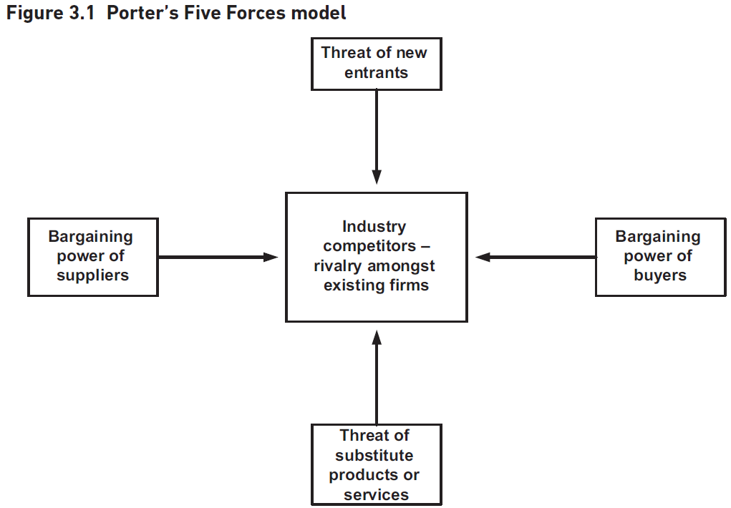
Competition Analysis using Porter's Five Forces
Market Growth Challenges
Slow or stagnant market growth
High fixed costs making price adjustments difficult
Product Differentiation Issues
Commoditized products with little brand loyalty
Porter's Framework
Application to Competition Analysis
Barriers to Entry
Supplier Power
Customer Power
Threat from Substitutes
Competitive Rivalry
Notes:
Porter's Five Forces model helps analyze market growth, product differentiation, and competitive rivalry. It identifies key competitive forces, evaluates industry profitability, and aids in strategy development. Barriers to entry, supplier power, customer power, and threats from substitutes are crucial factors impacting competition. Original Content: the market is growing only slowly or not growing at all; the industry has high fixed costs and responding to price pressure is difficult; products are not well differentiated or are commoditised so there is little brand loyalty; the costs of leaving the industry are high. Porter’s framework is simple to use and understand and it helps to identify the key competitive forces affecting a business. It is widely used in the development of strategies. There are, however, some weaknesses of which the most often mentioned is that government is not treated as the sixth force. Porter’s response is that the role of government is played through each of the five forces – for example, legislation affects entry and rivalry – and so it has not been ignored. There are also views that it is difficult to apply the model to not-for-profit organisations and that since the 1980s the increasing development of international businesses has led to a more complex set of competitive and collaborative relationships. Nonetheless it is widely accepted as a useful analytical tool. Having examined the external environment we should now consider the competition our organisation faces. Few businesses have no competition, even those in the not-for-profit sector, and most seek to develop and keep a competitive advantage over their rivals. They aim to be different or better in ways that appeal to their customers. An analysis tool that helps to evaluate an industry’s profitability and hence its attractiveness is Michael Porter’s Five Forces model (Porter 1980). This is shown in Figure 3.1 below. In the centre is the competitive battleground where rivals compete and where competitive strategies are developed. Organisations need to understand the nature of their competitive environment. Additionally, they will be in a stronger position if they understand the interplay of the five forces and can develop defences against the threats they pose. New entrants may want to move into the market if it looks attractive and if the barriers to entry are low. Globalisation and deregulation both give new entrants this opportunity but there are barriers to entry that organisations build. These include: Economies of scale. This may be difficult to achieve for a new entrant. Substantial investment required. A new entrant may have difficulty in obtaining sufficient funds for investment. Product differentiation. If existing products and services are seen to have strong identities, which are supported by high expenditure or branding, then new entrants may be deterred from entry. Access to distribution channels. Existing distribution channels may be booked by existing suppliers requiring new entrants to find new and different distribution channels The existence of patented processes. The need for regulatory approval, for example, in the financial and defence sectors. Supplier power limits the opportunity for cost reductions when: there is a concentration of suppliers and when supplying businesses are bigger than the many customers they supply; the costs of switching from one supplier to another are high. This may be because of clauses in supply contracts, interacting IT systems between the organisation and its suppliers, supply logistics or the inability of other suppliers to deliver; the supplier brand is powerful, for example, the power of ‘Intel Inside’; customers are fragmented so do not have a collective influence. Customer power – or the bargaining power of buyers as Porter called it – is high when: there are many small organisations on the supply side. For example, in the supply of food products to supermarkets; alternative sources of supply are available and easy to find; the cost of the product or service is high, encouraging the buyer to search out alternatives; switching costs are low. The threat from substitute products is high when: product substitution from new technologies is more convenient; the need for the product may be replaced by meeting a different need; it is possible to decide to ‘do without it’! All of these forces impact on the competitive battleground in some way. There may also be high competitive rivalry when: there are many competing firms; buyers can easily switch from one firm to another;

Slide 20
Scenario Planning for Future Impacts
Importance of External Environment Analysis
PESTLE and Porter provide useful data
High level of uncertainty in the world
Role of Scenarios in Planning
Evaluate medium- and long-term futures
Prepare organization for different futures
Identifying Key Factors
High impact and high uncertainty factors
More than two scenarios needed
Constructing Future Scenarios
Consider possible steps and 'what if?' questions
Sources of Information
Notes:
To understand future impacts, we use scenarios based on PESTLE and Porter analysis. Scenarios help evaluate medium- and long-term futures, preparing organizations for various possibilities. We identify high impact and high uncertainty factors, construct detailed scenarios, and consider predetermined events and key uncertainties. PESTLE analysis provides the necessary data. Original Content: Having used PESTLE and Porter to analyse the external environment, we will have much useful data about the external conditions the organisation may face. However, even with this information, the world springs surprises on organisations from time to time. There is a high level of uncertainty and some different approaches are needed to understand potential future impacts. Scenarios may be used to do this. They look at the medium- and long-term future and, by evaluating possible different futures, prepare the organisation and its managers to deal with them. They begin by identifying the potential high impact and high uncertainty factors in the environment. It is tempting to choose just two scenarios – good and bad – when doing this, but really four or more are needed and they should be plausible and detailed. Next, the future scenarios these factors could construct are considered, possibly by looking at the possible steps and asking ‘what if?’ questions. In doing this we are concerned with predetermined events such as predicted demographic changes, key uncertainties – often political and economic, including regulation and world trade – and driving forces such as technology and education. This information comes from the PESTLE analysis.

Slide 21
MOST Analysis Technique
External Environment Impact
Creates opportunities and threats
Stimulates strategy development
Organizational Capability
Ability to adapt to changing environments
Innovative exploitation of capabilities
Resource Audit and Portfolio Analysis
Resource audit helps in internal analysis
Boston Matrix used for portfolio analysis
MOST Analysis Technique
Importance of Clear Mission and Objectives
Evaluating MOST Analysis
Notes:
The external environment impacts strategy development by creating opportunities and threats. Organizational capability is crucial for adapting and innovating. Techniques like resource audit and Boston Matrix help in internal analysis. MOST analysis examines mission, objectives, strategy, and tactics. Clear mission and objectives enhance capability, while lack of direction weakens it. Evaluating MOST involves checking if objectives are SMART, strategy alignment, and effective communication. Original Content: The external environment creates opportunities and threats and can give an ‘outside/in’ stimulus to the development of strategy. Successful strategies depend on something else as well; it is the capability of the organisation to perform. Can an organisation continue to change its capability so that it constantly fits the environment in which it operates? Can it always be innovative in the way it exploits this capability? Two techniques that help in the analysis of the internal organisation are discussed in this section – the resource audit and portfolio analysis using the Boston Matrix. All of this begins, however, with an understanding of the current business positioning, and for this we will consider the MOST analysis technique. MOST analysis examines the current mission, objectives, strategy and tactics and considers whether or not these are clearly defined and supported within the organisation. We can define the MOST terms as follows: Mission: A statement declaring what business the organisation is in and what it is intending to achieve. Objectives: The specific goals against which the organisation’s achievements can be measured. Strategy: The medium to long-term approach that is going to be taken by the organisation in order to achieve the objectives and mission. Tactics: The detailed means by which the strategy will be executed. A clear mission driving the organisation forward, a set of measurable objectives and a coherent strategy will enhance the capability of the organisation and be a source of strength. On the other hand, where there is a lack of direction, unclear objectives and an ill-defined strategy the internal capability is less effective and we have a source of weakness. When considering the MOST analysis as a means of identifying strengths and weaknesses, it is useful to think about the following aspects: Is the MOST clearly defined? For example, are the objectives well-formed and SMART (Specific, Measurable, Achievable, Relevant and Time framed)? Is there congruence between elements of the SWOT (strengths, weaknesses, opportunities, threats)(see below)? For example, is the strategy aligned with the objectives? Has the MOST been communicated to the managers and staff of the organisation?

Slide 22
Resource Audit
Inside/Out Approach to Strategy
Starts from within the organisation
Belief in creating new products and services
Resource Audit for Identifying Core Competences
Highlights strengths and weaknesses
Five key areas to examine
Physical Resources
Includes buildings, equipment, land
Can be modern or outdated
Financial Resources
Human Resources
Intangible Resources
Notes:
Reflecting on core competences initiates the strategy process from within the organisation. The Resource Audit helps identify strengths and weaknesses across five key areas: physical, financial, human, and intangible resources. These resources determine the organisation's ability to create new products and services, invest in new resources, and maintain its reputation. Original Content: Reflecting on core competences starts the strategy process from inside the organisation so it is an ‘inside/out’ approach based on the belief that competitiveness comes from an ability to create new and unexpected products and services from a set of core competences. The Resource Audit can help us to identify core competences or may highlight where there is a lack of competence that could undermine any competitive moves. There are five key areas to examine, the first three being sets of tangible resource: The first area relates to the physical resources that the organisation owns or has access to and includes features such as buildings, plant and equipment, land and so on. These may be modern and cost-effective or old-fashioned, unreliable and incur high maintenance costs. Second, there are the financial resources that determine the organisation’s financial stability, capacity to invest in new resources and ability to weather business fluctuations and changes. Then, there are the human resources and their expertise, adaptability, commitment, etc. There are then the intangible resources such as the know-how of the organisation which may include actual patents or trademarks, but this may also be derived from the use made of resources such as information and technology; many organisations hold a large amount of information but it is not available when required or not in a format that can be used easily. Another intangible resource is the reputation of the organisation, for example the brand recognition and the belief that is held about the quality of the brand, and the goodwill – or antipathy – that this produces. An analysis of the organisation’s resources will identify where these provide a source of competence – strengths, or where there is a lack of capability – weaknesses.

Slide 23
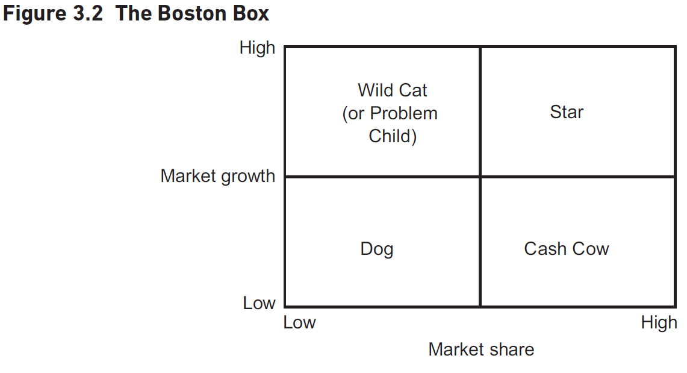
Portfolio Analysis using Boston Matrix
Importance of Portfolio Analysis
Regular review of business units
Decisions on resource investment
Boston Box by Boston Consulting Group
Identifies strategic business units (SBUs)
Models revenue potential against market share
Categories in the Boston Box
Cash Cows: Mature products/services in low growth markets
Stars: High potential in growth industries
Wild Cats: Unprofitable but future investments
Dogs: Low market share in low growth markets
Investment Strategies
Notes:
Portfolio analysis helps organizations decide on resource investment for business units. The Boston Box categorizes SBUs into Cash Cows, Stars, Wild Cats, and Dogs, guiding investment strategies like milking cows, investing in stars, examining wild cats, and removing dogs. Original Content: The portfolio of business units, each offering their own products and services, may also be a source of strength or weakness for an organisation. Organisations need to review their portfolio on a regular basis in order to take decisions about the resources to be invested into each business unit or even each product or service. Portfolio analysis was developed to address this problem. The original portfolio matrix – the Boston Box – was developed by the Boston Consulting Group and provides a means of conducting portfolio analysis. A company’s strategic business units (SBUs) – parts of an organisation for which there is a distinct and separate external market – are identified and the relationship between the SBU’s current or future revenue potential is modelled against the current share of the market. The Boston Box uses these two dimensions to enable organisations to categorise their SBUs and their products/services, and thereby consider whether and how much to invest. Put simply as in Figure 3.2, the cows are milked, the dogs are buried, the stars get the gold and the wild cats are carefully examined until they behave themselves or join the dogs and die. until it dies or is revitalised as a new product or service or SBU. The Wild Cats (or Problem Children) are unprofitable but are investments for the future; the Stars strengthen their position in a growth industry until they become the big profit earners. The Cash Cows are the mature products or services, in markets with little, if any, growth. The Stars and Cash Cows provide the funding for the other segments of the matrix. The Dogs have low market share in markets with low growth and are often the areas that are removed or allowed to wither away.

Slide 24
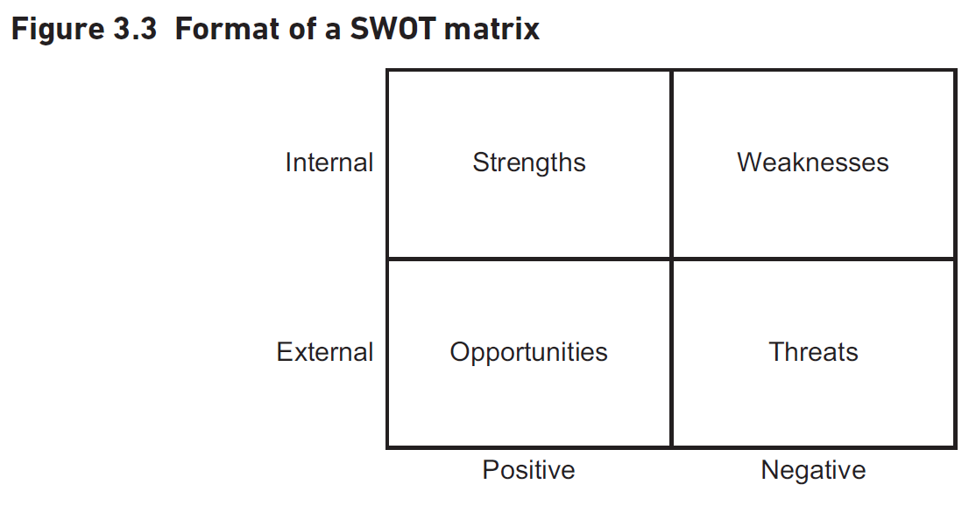
SWOT Analysis
SWOT Analysis Overview
Combines external and internal environment analysis
Often misused as the first analytical tool
Robust Analytical Approach
Use preparatory techniques to identify major factors
Summarizes key strengths, weaknesses, opportunities, and threats
Language and Representation
Needs to be brief and specific
Strengths and weaknesses measured against competition
Supported by evidence
Examples of SWOT Components
Balance Between Analyses
Notes:
SWOT analysis combines external and internal environment analysis. It should not be the first tool used. Use preparatory techniques to identify major factors. Language should be brief and specific. Examples include strong product branding and poor cash flow. Balance external and internal analyses for robust strategic direction. Original Content: The SWOT (strengths, weaknesses, opportunities, threats) analysis is often used to pull together the results of an analysis of the external and internal environments. However, too often it is used as the first analytical tool before enough preparatory analysis has been done. When this approach is adopted the results are usually weak, inconclusive and insufficiently robust to be of much use. A more robust approach is to use the techniques described earlier as they help identify the major factors, both internal and external to the organisation, that the business strategy needs to take into account. Hence, the SWOT analysis is where we summarise the key strengths, weaknesses, opportunities and threats in order to carry out an overall audit of the strategic position of a business and its environment. A SWOT analysis is often represented as a two-by-two matrix as shown in Figure 3.3. The language of a SWOT is important. It needs to be brief, with strengths and weaknesses related to critical success factors. Strengths and weaknesses should also be measured against the competition. All statements should be specific, realistic and supported by evidence. Some examples – not for the same organisation – could be: Strengths Strong product branding – market research shows a high awareness of our brands compared with the competition. We secure ‘best space’ in all branches of the top five retailers. Weakness We have poor cash flow. Against industry benchmarks we are in the bottom quartile. We exceed our overdraft limits on 19 days every quarter. Opportunity Demographic change in Europe and the US will provide a greater market for our products. Threat Low market growth will see increased concentration of business through acquisition. The poorest performing businesses will fail. A key point that emerges from these examples is that strengths and weaknesses are found within the organisation (and hence discovered via the resource audit or the Boston Matrix) whereas opportunities and threats arise from outside the organisation (and hence can be found using PESTLE or the Five Forces model). It is important to get right the balance between the external and the internal analysis. Completely changing the nature of the organisation because of the external analysis may lead to radical change but without any assurance that capability exists to deliver this successfully. Basing everything on an internal analysis may lead to little or no change, or changes that are internally focused and ignore the desires of the customers. Using both analyses is more balanced and is likely to contribute towards the creation of a more robust strategic direction

Slide 25
Contextual Issues in Strategy Execution
Context for Strategy
Time: Speed of implementation
Scope: Size of change
Capability: Resources and adaptability
Readiness: Organizational readiness
Strategic leadership: Presence of a strategic leader
Role of the Leader
Guiding the change process
Ensuring alignment with strategic goals
Tools for Implementation
Balanced Business Scorecard
McKinsey 7-S Model
Notes:
Implementing new strategies involves risk due to change. Key aspects include context, leadership, and tools like the Balanced Business Scorecard and McKinsey 7-S Model. Consider time, scope, capability, readiness, and strategic leadership. Original Content: Executing new strategies implies risk because it involves change. There are three particular aspects of implementing strategy – the context for the strategy, the role of the leader and two tools that we can use – the Balanced Business Scorecard and the McKinsey 7-S Model. There are five contextual issues to be considered. Time – how quickly does the new strategy need to be implemented? What pace of change is needed? Scope – how big is the change? Is the new strategic direction transformational or incremental? Capability – does the organisation have the required resources for the change? is the organisation adaptable and able to change? Are the experiences of change positive or negative? Readiness – is the whole organisation, or the part of it to be affected, ready to make the change? Strategic leadership – is there a strategic leader for the change?

Slide 26
Role of Strategic Leadership
Challenges the Status Quo
Sets new and demanding targets
Does not tolerate unsatisfactory behaviour or performance
Establishes and Communicates Vision
Defines direction, mission, objectives, strategies, and tactics
Communicates values underpinning the business
Models the Way
Demonstrates desired behaviour and actions
Empowers People
Encourages others to play their part in strategic change
Celebrates Success
Recognizes and rewards achievements
Notes:
A strategic leader plays a key role in driving change within an organization. They challenge the status quo, set clear visions and objectives, model desired behaviors, empower others, and celebrate successes. Original Content: In this context, the strategic leader will have the key role. Typically, the strategic leaders we read about are the top managers but strategic leadership does not have to be delivered from the top; there are many successful strategic changes that have been driven from other parts of the organisation. The leader needs to demonstrate the following key characteristics: Challenges the status quo all the time and sets new and demanding targets, never being prepared to tolerate unsatisfactory behaviour or performance. Establishes and communicates a clear vision of the direction to be taken, why it has to be taken and how the journey will be made. This means establishing the new mission, setting out objectives, identifying the strategies for achieving them and defining the specific tactics to deliver them. The leader also clearly communicates the values that underpin the business. ‘Models the way’ or ‘Walks the walk’. He or she demonstrates through their behaviour how everyone else should behave and act in order to deliver the strategy. Empowers people to deliver their part of the strategic change within the vision, values and mission that have been set out. The leader cannot be everywhere, so others need to play their part. Celebrates success with those who achieve it.

Slide 27
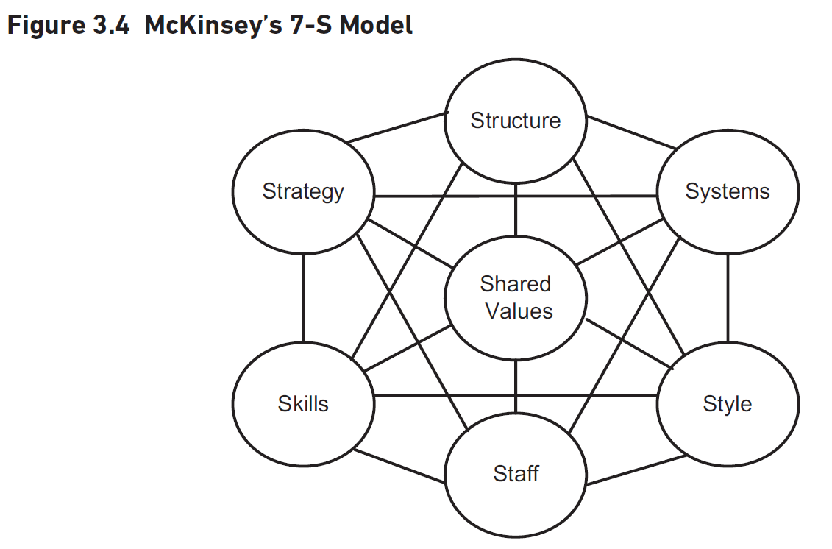
Tools for Strategy Execution: McKinsey 7-S Model
McKinsey 7-S Model
Consists of seven components
Three 'hard' components: strategy, structure, systems
Four 'soft' components: shared values, style, staff, skills
All components are interlinked
Changes in one component affect others
Balanced Business Scorecard
Shown in Figure 3.5
Importance of connections between components
Disconnects can flaw strategy execution
Notes:
Two tools for strategy execution are the McKinsey 7-S Model and the Balanced Business Scorecard. The 7-S Model includes seven interlinked components, both 'hard' and 'soft'. Changes in one component affect others. The Balanced Business Scorecard is shown in Figure 3.5. Connections between components are crucial for successful strategy execution. Original Content: Two tools that help in the execution of strategy are the McKinsey 7-S Model shown in Figure 3.4 below and the Balanced Business Scorecard shown in Figure 3.5. The 7-S model supposes that all organisations are made up of seven components. Three are often described as ‘hard’ components – strategy, structure and systems, and four as ‘soft’ – shared values, style, staff and skills. These are the seven levers that can be used in the implementation of strategic change and they are all interlinked. All seven need attention if the strategy is to be executed successfully, because if there is a change with one, others will be affected. Changing one element, such as the strategy, means that all of the others have to change as well. The structure – the basis for building the organisation will change to reflect new needs for specialisation and coordination resulting from the new strategic direction. Formal and informal systems that supported the old system must change. The style or culture of the organisation will be affected by a new strategic direction. Values, beliefs and norms, which developed over time, may be revised or even swept away. The way staff are recruited, developed and rewarded may change. New strategies may mean relocating people or making them redundant. Skills – competences acquired in the past may be of less use now. The new strategy may call for new skills. Shared values are the guiding concepts of the organisation, the fundamental ideas that are the basis of the organisation. Moving from an ‘engineering first’ company to a ‘customer service first’ company would change the shared values. As important as the individual elements of the 7-S model, are the connections between them. The execution of strategy will be flawed if, for example, there is a disconnect between the style adopted by management and the shared values of the organisation

Slide 28
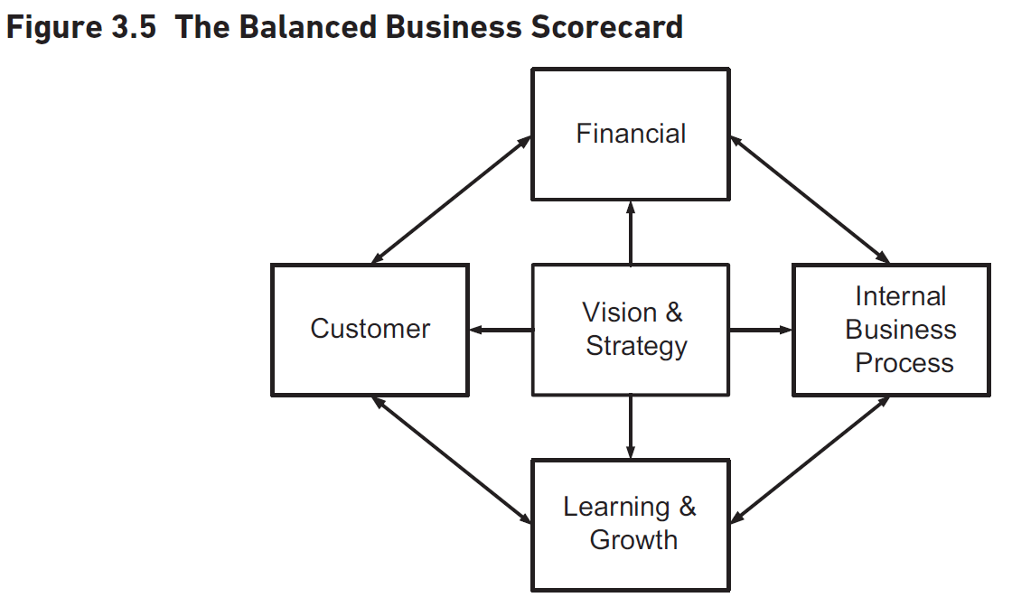
Tools for Strategy Execution: Balanced Business Scorecard
Strategic Balance Sheet
Assesses financial and non-financial components of strategy
Four Perspectives of Performance
Customer Perspective
Internal Processes
Learning and Growth
Questions Addressed by Each Perspective
Critical Success Factors (CSFs)
Key Performance Indicators (KPIs)
Healthcare Example
SMART KPIs
Identifying Critical Success Factors
Notes:
The Balanced Business Scorecard (BBS) is a strategic tool that assesses both financial and non-financial components of a strategy. It includes four perspectives: financial, customer, learning and growth, and internal business processes. Critical Success Factors (CSFs) and Key Performance Indicators (KPIs) are vital for evaluating performance. For example, in healthcare, financial KPIs monitor drug costs. KPIs should be SMART and regularly monitored. Original Content: The Balanced Business Scorecard (BBS) can be thought of as the strategic balance sheet for an organisation as it captures the means of assessing the financial and non-financial components of a strategy. It therefore shows how the strategy execution is working and the effectiveness with which the levers for change are being used. The BBS supplements financial measures with three other perspectives of organisational performance – customers, learning and growth, and internal business processes. Vision and strategy connect with each of these as shown in Figure 3.5. The emphasis of the scorecard is to measure aspects of performance in a balanced way. In the past, managers have perhaps paid more attention to the financial measures but the BBS shows it is important to consider all of the four aspects. The customer perspective measures those critical success factors that provide a customer focus. It forces a detailed examination to be made of statements like ‘superior customer service’ so that everyone can agree what it means, and measures can be established to show the progress being made. It also identifies the need to consider how the customers view the organisation and its products or services. The delivery of value to the customers is likely to affected by the internal processes so the process effectiveness also needs to be measured. The learning and growth perspective could generate a need for new products or new internal processes if the organisation is to continue to perform well. All of these aspects are important when evaluating organisational performance. Each perspective answers questions like these: Financial – what level of income has been generated? How profitable is the business? Customer – how will we assess our customer satisfaction? Learning and Growth – how will we measure our ability to change and improve so that we constantly keep ahead of the competition? Internal Business Processes – how effective are the business processes that we must excel at to deliver customer value? The BBS helps in the definition of two components which are vital to assess business performance; these are Critical Success Factors (CSFs) and Key Performance Indicators (KPIs). The concept of CSFs was initially developed in the late 1970s when they were defined as ‘the few key areas where “things must go right” for the business to flourish and for a manager’s goals to be attained’ (Rockart in the Harvard Business Review, March/April 1979). The important words here are ‘few’, key’ and ‘must’. Not every activity is a key area; they are fewer in number than people think and success with them is critical but the CSFs mean that there are some goals that must be reached. However, it is of little use setting goals and then realising too late that you won’t make it. This is where KPIs are required. KPIs are the measures that show whether or not progress is being made towards the achievement of a CSF. KPIs measure specific areas of performance so also limit the amount of data that managers have to consider and act upon. Let us see how this could work for a healthcare organisation, such as a hospital, using the BBS as a framework. First, the CSFs in the financial area will be considered. The hospital management might state that income must be greater than expenses, perhaps by a set percentage. It is important that the hospital sets this CSF specifically for its own circumstances rather than using a national target. CSFs must be our CSFs or there would be little identification with the effort required to achieve them. Generated from this CSF might therefore be strict cost control on the purchase of drugs and of treatment equipment. So, we would set financial KPIs to monitor and control the prescription of drugs and treatments; each KPI would have a set target which, in this case, could be a defined budget for expenditure of drugs and treatments each year. This is also an example of where CSFs in one area can affect CSFs in other areas; if the low cost drugs and treatments we use mean that it takes longer to get better with us, then how does that impact on a customer service CSF of reducing the waiting time for treatment? It’s important that KPIs are defined such that they are SMART and that they are monitored regularly. If the drugs budget is exceeded within the first few months, what action will be taken to bring it back to budget before the overspend becomes too difficult to manage? Other parts of the BBS can also generate CSFs so long as they are critical; for our hospital it is tempting to regard patient satisfaction as a critical success factor. Is it really critical or should the goal be to improve people’s health, provide life-saving surgery and so on? It can be difficult to determine the truly critical success factors. It is an excellent discipline to ensure that only those that are critical are identified; it is not possible to monitor too many factors at one time. There is a suggestion later in Chapter 6 about how CSFs and KPIs could be used in the construction of Business Activity Models.

Slide 29
Summary
Reasons for Strategy Development
Understanding why organizations develop strategies
Exploring the complexity of the process
Approaches to Strategy Development
Entrepreneurial approaches
Formal planning methods
External Factors Influencing Strategy
Outside/in approach
Internal Analysis Approach
Inside/out approach
Execution of Strategy
IS strategy considerations
Notes:
This chapter discusses why organizations develop strategies and the complexity of this process. It covers entrepreneurial and formal planning approaches, external and internal factors influencing strategy, and execution considerations including performance measurement using BBS, CSFs, and KPIs. Original Content: SUMMARY This chapter has looked at the reasons why organisations develop strategies and how they might do this. We have explored the complexity of this process and offered ideas about how strategies are developed taking account of entrepreneurial approaches and formal planning. The chapter has also described the external factors influencing strategy – the outside/in approach – and an internal analysis approach – the inside/out approach. Finally we looked at the execution of strategy and IS strategy considerations such as performance measurement using the BBS, CSFs and KPIs.

